Slide 1




Log Ingestion, Parsing, and Normalization
CompTIA CySA+ CS0-004 | Objective 1.1
Ingestion
Parsing
Normalization
Centralized SIEM
Collecting raw logs from
endpoints, network
devices, cloud services,
and applications.
Extracting relevant
technical data from
unstructured log formats
into structured fields.
Aligning diverse data
formats into a common
schema for unified analysis
and correlation.
The destination for
processed data to enable
security monitoring and
incident response.
Han’s IT Academy | CySA+ CS0-004 | Independent Training

Slide 2






Why the Data Lifecycle Matters
Transforming raw telemetry into actionable security intelligence
Security Source
Collection
Parsing
Normalization
Enrichment
Detection
Capturing raw
telemetry from
diverse
endpoints and
infrastructure.
Centralizing
data streams for
unified
processing.
Converting
unstructured
logs into
meaningful
fields.
Applying a
common
schema for
cross-platform
consistency.
Adding context
like threat
intelligence and
user identity.
Executing
analytics to
identify threats
with precision.
A robust pipeline is the foundation of effective security analytics and actionable insights.

Slide 3
What is Log Ingestion?
Systematic collection and transport of event data for centralized analysis
Operating Systems
Network
Infrastructure
Identity & Access
Cloud Infrastructure
Aggregation of Windows
and Linux server activity
logs.
Centralization of Identity
Provider (IdP)
authentication logs.
Ingestion of logs from
various cloud platform
services.
Capture of firewall
activity and critical DNS
queries.
The fundamental question is: Did the platform receive the event? Ensuring total visibility and data integrity across the entire stack.

Slide 4


Common Ingestion Methods
A comparison of data collection strategies for monitoring and security
Method
Best Use
Strength
Limitation
Agents
Host-level monitoring
Deep visibility
High resource overhead
Agentless
Legacy/restricted systems
Low deployment effort
Less granular data
Syslog
Network devices/firewalls
Lightweight/standard
UDP packet loss risk
API
SaaS/Custom apps
Highly precise data
Complex implementation
Cloud-connector
Managed cloud services
Scalable/Reliable
Provider-specific logic

Slide 5
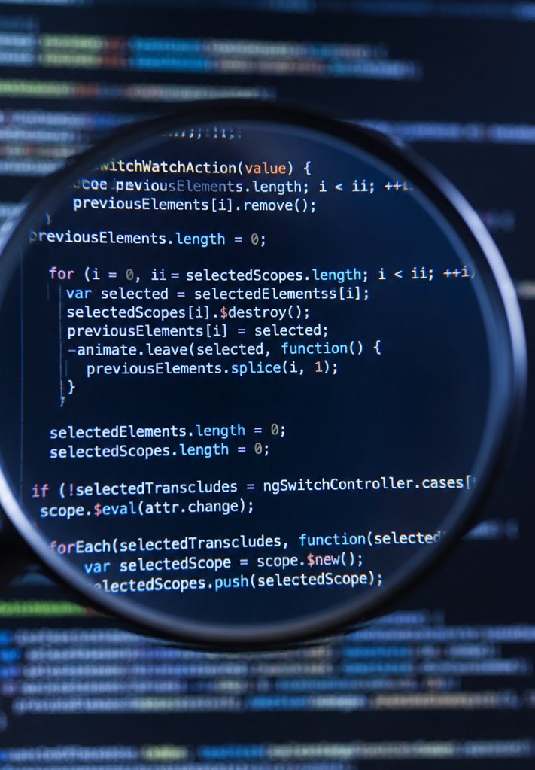
Data Parsing Overview
What is Parsing?
Definition
Extracting meaningful, structured fields from unstructured raw data.
Practical Example
Raw Log: "Aug 05 14:32:18 fw01 DENY..."
Decomposed Fields:
  Timestamp: Aug 05 14:32:18
  Device: fw01
  Action: DENY
  Source IP: [Parsed IP]
  Destination IP: [Parsed IP]
  Protocol: [Parsed Protocol]
The Core Objective: Moving from raw text to structured insight.

Slide 6

Data Standardization
What is Normalization?
Definition & Objective
Definition: The systematic process of mapping diverse
vendor fields into a single, unified, and consistent schema.
Core Objective: Eliminating ambiguity in data representation
to enable seamless analysis and correlation.
Practical Example
Vendor A: uses 'src_ip'
Vendor B: uses 'sourceAddress'
Vendor C: uses 'client.ip'
Standardized Schema: All map to 'source_ip'
How do we ensure that activity is described consistently across all platforms to enable effective security monitoring?

Slide 7
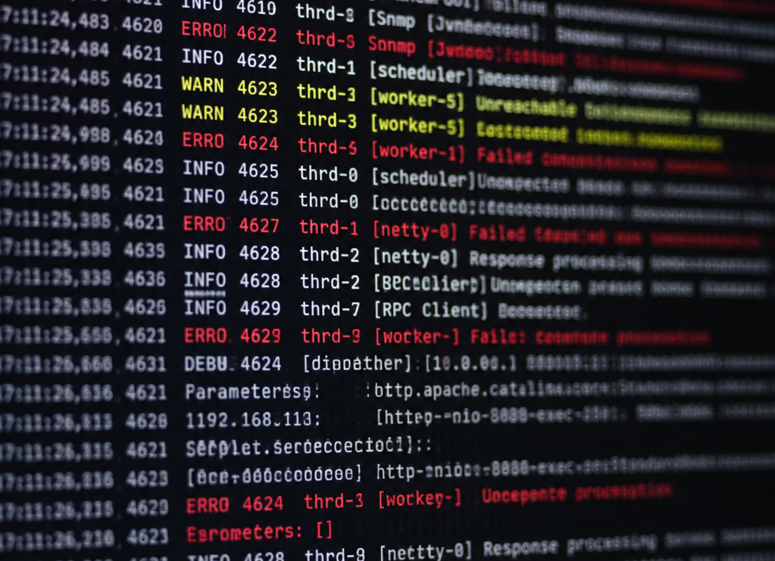
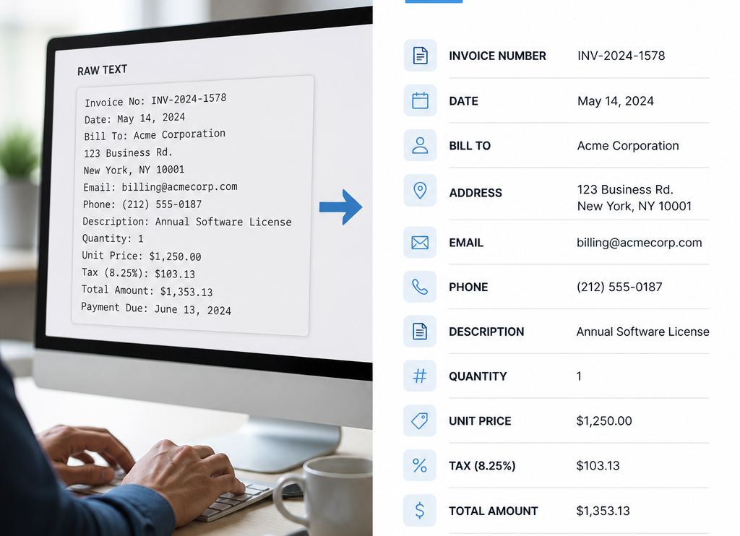
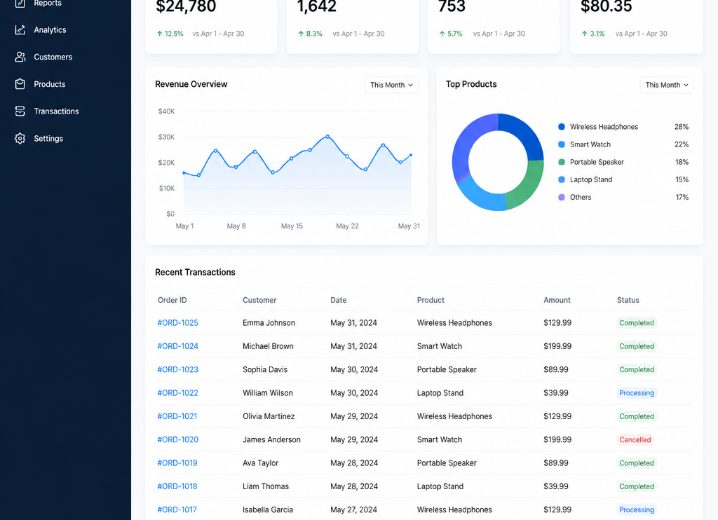
Raw vs. Parsed vs. Normalized
The Lifecycle of a Log Event
Raw
Parsed
Normalized
Unstructured, vendor-specific output containing
noise, raw headers, and inconsistent delimiters.
Difficult to query or correlate at scale.
Key-value pairs extracted from raw strings
using regex or patterns. Maintains original,
vendor-specific field names.
Standardized against common schemas like
ECS or OCSF. Features consistent field naming
and data types for cross-platform analytics.

Slide 8
Realistic SOC Scenario: The Normalization Challenge
Overcoming Identity Fragmentation through Unified Correlation
The Problem: Identity Fragmentation
  Logs from Windows Endpoints, Cloud Environments, and
  VPN Gateways utilize disparate formats and
  nomenclature, preventing manual correlation.
The Solution: Cross-Platform Correlation
  Standardize logs into a Common Information Model
  (CIM) and map disparate identifiers (SID, Email, IP) to a
  single 'User Object'.
Advanced Detection
  Enable detection rules that evaluate sequences of events
  across platforms rather than isolated log entries.
Outcome: Real-time identification of cross-platform credential abuse and lateral movement.

Slide 9

What Can Go Wrong?
Key failure points in system integration and data processing
API Permission Issues
  Insufficient scope or incorrectly
  configured access rights.
Expired Tokens
  Authentication failure due to
  stale or invalid session
  credentials.
Parser Mismatches
  Incompatibility between data
  structures and ingestion logic.
Truncated Events
  Data loss during transmission
  resulting in partial or incomplete
  logs.
Inconsistent Time-
stamping
  Synchronization errors affecting
  the chronological integrity of
  data.

Slide 10
Analyst Validation Checklist
A 10-point verification framework to ensure data integrity
Source Verification
  Confirm data origin and
  credential authenticity.
Timestamp Integrity
  Validate UTC offsets and
  sequence continuity.
Field Mapping
  Ensure source-to-target
  schema alignment.
Normalization Testing
  Verify raw-to-normalized value
  transformations.
Duplicate Detection
  Identify and remove redundant
  record entries.
Null/Empty Analysis
  Audit critical missing values in
  mandatory fields.
Range Checking
  Ensure numerical values fall
  within logical boundaries.
Reconciliation
  Compare aggregated totals
  against source system reports.
Cross-Reference
  Validate foreign key
  relationships across datasets.
Precision Audit
  Confirm decimal/rounding
  consistency across
  calculations.

Slide 11
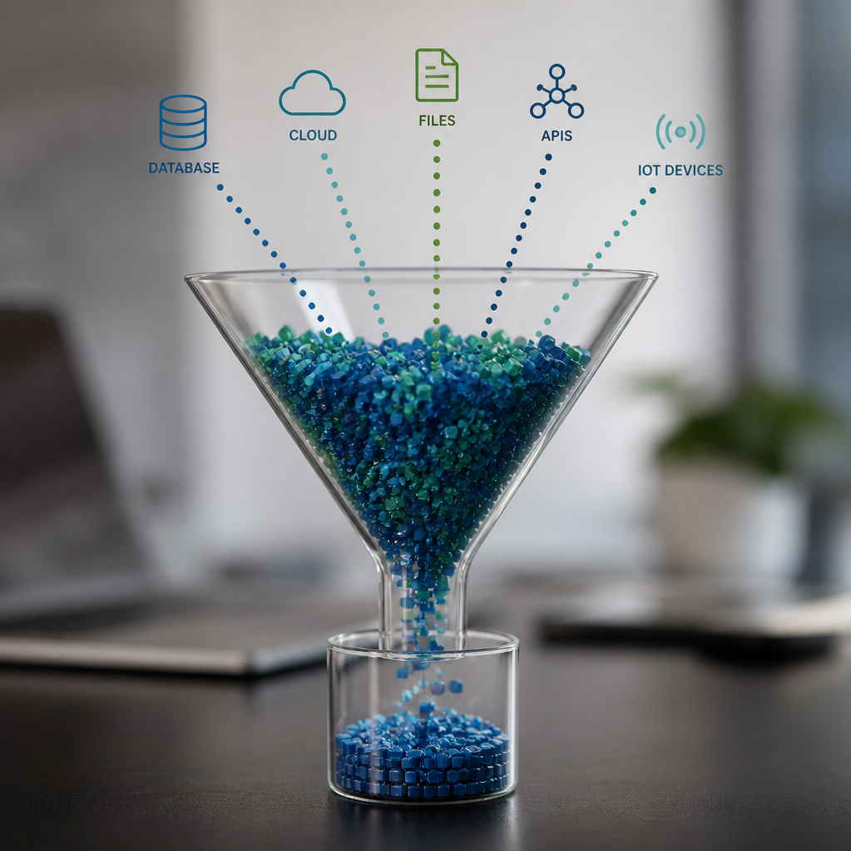
Exam Decision Rules
Standardized framework for data processing and integrity
Ingestion
  Receive and capture all incoming raw data inputs.
Parsing
  Separate and extract distinct data elements from the raw stream.
Normalization
  Standardize data into a consistent, unified format.
Validation
  Perform integrity checks to flag missing packets and resolve correlation
  failures.

Slide 12
Knowledge Check: Data Pipeline Integrity
Identifying failure points in data engineering workflows
Ingestion Failure
  API authentication changes represent failures at the
  Ingestion Layer as they block initial connectivity.
Parsing Error
  Malformed JSON issues occur during the Parsing Phase
  while converting raw data into object models.
Normalization Logic
  Missing lookup table entries trigger failures during the
  Normalization or Transformation stage.
Data Quality
  Non-null constraint violations are caught during Data
  Validation to prevent downstream data pollution.

Slide 13
Final Summary: Pipeline Core Functions
Standardizing and verifying data integrity for downstream reliability.
Ingestion
  Centralizing data inflow from disparate sources.
Parsing
  Extracting specific fields from unstructured log formats.
Normalization
  Mapping varied schemas into a standardized structure.
Trust, but Verify: Before relying on downstream alerts, ensure the integrity of the data
pipeline. Disclaimer: Independent educational content; no affiliation with CompTIA or other
entities.

