Slide 1



Log Retention and Storage Strategy
CompTIA CySA+ CS0-004 | Objective 1.1. Micro Lesson 5
Active SIEM (Hot Storage)
Tiered Storage (Warm/Cold)
Long-Term Archives
Immediate ingestion, real-time alerting,
and correlation performed on high-
speed, indexed storage.
Migration of logs to secondary storage
tiers based on age and access
frequency to optimize performance
and costs.
Immutable storage (WORM) used for
compliance, regulatory requirements,
and historical forensic analysis.
Log Flow: Source Systems → Aggregation/SIEM (Hot) → Tiered Storage (Warm) → Archive (Cold) | Han’s IT Academy | CySA+ CS0-004

Slide 2

The Forensic Challenge: Why
Long-Term Retention Matters
Reconstructing the attack timeline requires access to historical telemetry
Step 2: Persistence &
Movement
Establishment of backdoors
and lateral movement
through the network.
Step 4: Investigation
Step 1: Initial Access
The critical period where
historical logs are needed to
reconstruct the breach.
Step 3: Detection
The point of entry where the
threat actor first
compromises the
environment.
Security alerts triggered
weeks after the initial
compromise occurred.

Slide 3


Retention vs. Storage
Understanding the distinction between data lifecycle management and infrastructure
Log Retention (The 'When')
Log Storage (The 'Where')
The duration for which data is preserved before deletion.
Focuses on regulatory compliance, audit availability, and
historical data needs. Question: 'How long do we keep it?'
The infrastructure used to maintain data throughout its
retention period. Focuses on access speed, cost optimization,
and data durability. Question: 'Where do we keep it?'

Slide 4
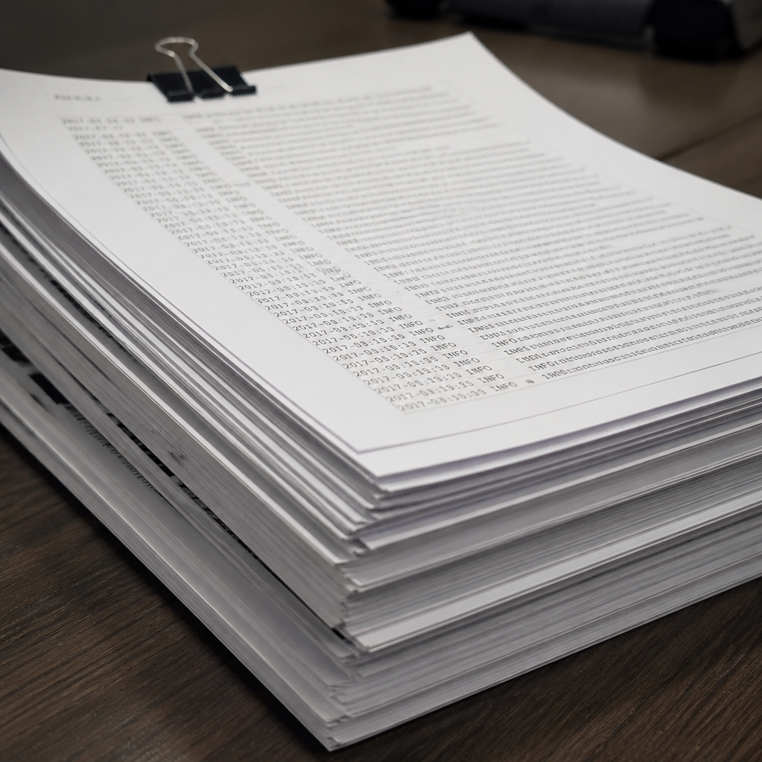
Why Organizations Retain Logs
Operational and security objectives of comprehensive log management
Security Operations
  Enables real-time monitoring, proactive threat hunting, and efficient
  incident investigation.
Forensics & Legal
  Provides an immutable record of truth essential for forensic analysis and
  legal discovery processes.
Compliance
  Ensures adherence to regulatory frameworks and facilitates the
  validation of internal controls.
Infrastructure Performance
  Supports root-cause analysis, trend identification, and continuous
  system optimization.

Slide 5


Factors That Determine Retention
Key Decision Drivers for Data Lifecycle Management
Regulatory & Legal Requirements
Organizational Policy
Threat-Detection Needs
Time-to-Discover
Ensuring adherence to mandatory
compliance and industry-specific
standards.
Aligning with internal governance and
corporate data management rules.
Maintaining logs and data necessary for
effective security analysis and incident
response.
Balancing the need for historical data
access with operational performance.
Data Sensitivity
Asset Criticality
Capacity, Speed, and Cost
Applying storage tiers based on classification levels and data
risk.
Prioritizing retention based on the strategic importance of the
data source.
Evaluating technical and financial constraints of storage
infrastructure.
The longest possible retention period is not automatically the best strategy.

Slide 6




Hot, Warm, Cold, and Archive Storage
Data Storage Tiering Strategy
1
High Performance
Immediate search capability at the highest cost.
2
Balanced
Moderate retrieval delay with balanced performance and cost.
3
Infrequent Access
Slower retrieval optimized for cost efficiency.
4
Long-term Retention
Lowest accessibility and cost for long-term storage.
Optimal data lifecycle management balances accessibility requirements against storage expenditures.

Slide 7




Tiered Storage Strategy
Lifecycle data management for performance and compliance
1
0–30 Days
Active, high-performance storage for immediate incident response and threat hunting.
2
31–180 Days
Balanced tier for active reporting and recent historical analysis.
3
181 Days–2 Years
Optimized for long-term historical trends and compliance reporting.
4
2+ Years
Deep storage for legal retention and long-term forensic
requirements.
Note: Exact periods are driven by business and legal requirements. Data is moved through the lifecycle, not simply deleted.

Slide 8


Retention by Log Value
Aligning Log Retention Periods with Security Use Cases
Category
Priority
Retention Period
Identity / Privileged Access
High
Long
Firewall / Endpoint
High
Medium-Long
Applications
Variable
Short-Medium
Health Data
Low
Short
Retention must align with specific security use cases to balance forensic requirements with storage efficiency.

Slide 9
Storage Capacity and Event Volume
Planning for growth, retention, and infrastructure overhead
The Capacity Planning Formula
Critical Adjustment Factors
Daily Volume × Avg Event Size × Retention Period = Total
Storage Requirement. Example: 200 GB/day at 90-day
retention requires 18 TB.
Account for indexing overhead (+20-50%), multi-node
redundancy, backup snapshots, and future growth
projections.

Slide 10

Risks of Retaining Too Little
Consequences of Premature Log Purging
Loss of Historical Context
  Inability to reconstruct past events or
  track long-term trends due to missing
  data.
Undetected Persistent Threats
  Slow-moving, low-and-slow attacks
  go unnoticed if they exceed the
  retention window.
Impeded Threat Hunting
  Critical telemetry required for
  proactive security investigations is
  wiped.
Compliance Violations
  Failure to meet mandatory data
  retention requirements for legal and
  regulatory standards.
Incomplete Root-Cause
Analysis
  Inability to identify the initial entry
  point or lateral movement trajectory
  after an incident.
Scenario: Attacker detected at Day 75, but logs purged at Day 30; 45 days of critical
forensic evidence lost, preventing full scope determination and remediation.

Slide 11
Risks of Retaining Too Much Data
Why excessive data retention is a strategic liability
Increased Storage Costs
Larger Breach Exposure
Privacy & Compliance Concerns
Accumulating redundant, obsolete, or trivial (ROT) data
inflates cloud and physical storage expenses.
Storing unnecessary data expands the attack surface,
increasing the potential impact of a data breach.
Extended retention conflicts with data minimization
principles required by GDPR, CCPA, and other
regulations.
Legal Discovery Burden
Slower Search Performance
Massive data footprints complicate legal holds and significantly increase the cost of
eDiscovery processes.
Excessive information volume hinders the ability to retrieve relevant assets, reducing
organizational efficiency.
Keeping everything forever can be both expensive and risky.

Slide 12







Integrity, Access, and Disposal
Data Lifecycle Management Stages
Generate and initialize data
assets.
Aggregate inputs from internal
and external sources.
Maintain data in secure,
accessible repositories.
Apply security controls to
ensure data integrity.
Create
Collect
Store
Protect
Retrieve
Archive
Dispose
Enable efficient access for
business operations.
Move aging data to long-term
storage.
Securely delete data or apply
legal holds.
Key requirements include utilizing persistent formats, ensuring continuous integrity validation, enforcing
strict access controls, maintaining compliance through audit trails, and following secure deletion protocols.

Slide 13

Case Study
Realistic SOC Scenario:
Tiered Storage Utility
The Incident
Threat Intel: Identified a 4-month-old malicious infrastructure pattern.
SIEM Constraints: Standard SIEM configuration limits hot data to 30 days.
Data Availability: 6 months of historical logs were archived in cold/compressed storage.
Outcome & Lesson
Success: The team successfully retrieved and indexed cold logs to confirm the scope of
historical impact.
Strategic Lesson: Implementing tiered storage architecture enables comprehensive
investigative capabilities without the prohibitive costs of maintaining all data on high-
performance infrastructure.
Tiered storage balances the need for long-term investigative visibility with infrastructure cost optimization.

Slide 14
Analyst Retention Checklist
Best practices for managing and preserving analytical data assets
Identify requirements
  Assess regulatory and internal
  data retention policies.
Map to use cases
  Align data preservation with
  ongoing analytical objectives.
Estimate growth
  Forecast data volume to inform
  capacity planning.
Define tiers
  Implement storage tiers based
  on data frequency and utility.
Test retrieval
  Conduct periodic audits to
  ensure long-term data
  accessibility.
Protect archives
  Secure historical datasets
  against corruption or loss.
Monitor access
  Track and control user
  permissions to sensitive
  information.
Apply legal holds
  Establish protocols for data
  preservation during legal
  requirements.
Document exceptions
  Maintain a formal record of all
  policy deviations.

Slide 15

Exam Decision Rules
A framework for effective data lifecycle management
Retain
Store
Tier
Define the duration for which data must be kept based
on operational value and compliance requirements.
Designate the appropriate storage environment based on
accessibility needs and security protocols.
Establish performance levels; higher-speed tiers are for
active use, while slower tiers are for cost-efficiency.
Archive
Dispose
Move long-term, infrequently accessed data to secondary storage for compliance or
historical preservation.
Securely purge data that has exceeded its retention period to minimize storage costs and
liability exposure.
Important Note: Legal holds take precedence over all standard deletion policies and must be strictly enforced.

Slide 16

Knowledge Check: Data Management
Test your understanding of storage and compliance best practices
Storage Tiers
Legal Holds
Determine cost-effectiveness of migrating
data to archive versus cold storage.
Suspend automated deletion policies to
comply with discovery requirements.
Retention Risks
Data Exposure
Identify primary dangers associated with non-
compliant data deletion cycles.
Analyze common vectors for unauthorized
internal access to sensitive datasets.
Cost-Benefit Strategies
Balance data accessibility requirements
against long-term storage overhead.
Refer to the Appendix for the Answer Key and detailed explanations for each scenario.

Slide 17

Key Takeaways
Final Summary
Retention vs. Accessibility: Retention drives
organizational survival; strategic storage ensures data
remains accessible when needed.
Risk & Cost Optimization: Implement data tiering to
balance operational costs against security and
compliance risks.
Integrity & Lifecycle: Maintain strict data integrity
throughout the lifecycle, concluding with secure, verified
disposal.
Keep the evidence long enough to matter—but no longer than the mission requires.

