Slide 1
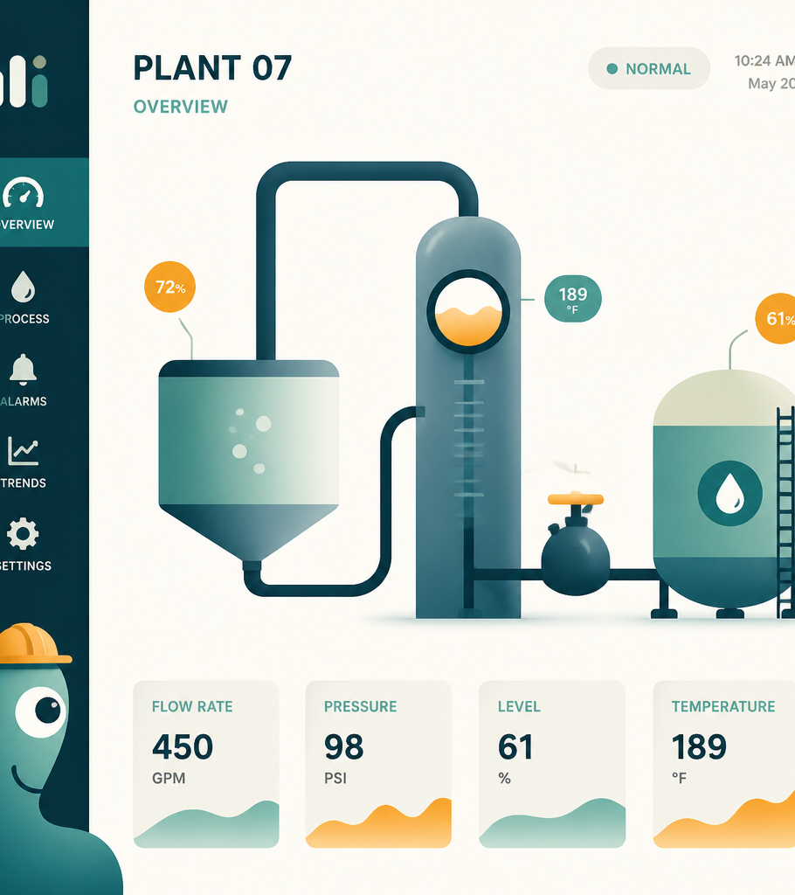
OVERVIEW OF OT SECURITY
Operational
Technology Security
Operational Technology (OT) involves hardware and software that
monitors and controls physical processes, devices, and
infrastructure.
KEY SYSTEMS
INDUSTRIAL CONTROL SYSTEMS (ICS), SCADA, PLCS, AND
DISTRIBUTED CONTROL SYSTEMS (DCS).
CORE DIFFERENCES: OT VS. IT
PRIORITY: AVAILABILITY AND PHYSICAL SAFETY (OT) VS. DATA
CONFIDENTIALITY/INTEGRITY (IT).
ENVIRONMENT: OFTEN UTILIZES LEGACY, PROPRIETARY, OR
CONSTRAINED HARDWARE.
CONVERGENCE: INCREASING INTERCONNECTIVITY WITH IT
NETWORKS CREATES NEW ATTACK VECTORS.
Security Focus: Identifying vulnerabilities in critical infrastructure
and managing risks in converged IT/OT environments.

Slide 2

What is Operational Technology (OT)?
Monitoring and controlling physical processes and infrastructure
DEFINITION
  Hardware and software systems designed to monitor or control physical
  processes, devices, and industrial operations.
CORE INDUSTRIES
  Critical sectors including Manufacturing, Power grids, Water treatment,
  Transportation, Oil & Gas, and Building Automation.
IT VS. OT DISTINCTION
  IT manages digital information; OT focuses on cyber-physical interactions,
  controlling real-world machinery like valves and actuators.
OT IS DEFINED BY ITS 'CYBER-PHYSICAL' NATURE, PRIORITIZING THE SAFETY AND
OPERATIONAL CONTINUITY OF PHYSICAL INFRASTRUCTURE OVER PURE DATA PROCESSING.

Slide 3



IT vs. OT: Critical Differences
Understanding the shifting priorities between information and operational systems
IT (Information Technology)
OT (Operational Technology)
Key Takeaway
Focuses on data, business systems, and
applications. Priorities prioritize confidentiality
and data integrity, where the primary risk is
unauthorized access.
Focuses on physical processes, machinery, and
production. Priorities center on safety and
equipment availability, where the primary risk is
physical catastrophe.
The priority hierarchy is inverse; IT treats
downtime as a business nuisance, while OT treats
downtime as a potential threat to life and
equipment safety.

Slide 4
Common OT Components
Essential hardware and software building blocks in industrial environments
FIELD DEVICES
  Physical infrastructure including sensors, actuators, motors,
  and valves that interact directly with the process.
CONTROLLERS
  Programmable Logic Controllers (PLC) and Remote Terminal
  Units (RTU) used to execute logic and manage remote
  operations.
SUPERVISORY SYSTEMS
  Human-Machine Interfaces (HMI) and Engineering
  Workstations that enable visualization and control for
  operators.
MANAGEMENT LAYER
  Historians and control servers responsible for data logging
  and system-wide management.
NETWORK
  Industrial Ethernet, serial connections, and specialized
  protocols facilitating communication across the environment.
THESE COMPONENTS SERVE AS THE CRITICAL BUILDING BLOCKS THAT REQUIRE CONSTANT MONITORING AND DEFENSE IN AN OT ENVIRONMENT.

Slide 5

Why OT Security is Different
Operational Technology vs. Traditional IT Constraints
CONTINUOUS OPERATION
ZERO-DOWNTIME
MULTI-DECADE LIFECYCLES
Systems must run 24/7/365 without any
interruption.
Production takes priority; maintenance windows
are rare and costly.
Critical infrastructure components are designed
to remain in service for over 20+ years.
LIMITED PATCHING CAPABILITY
LEGACY PROTOCOLS
SAFETY-FIRST REQUIREMENTS
Proprietary, legacy systems often lack modern
security update mechanisms.
Communication standards were built for function,
not security, often lacking encryption.
Physical safety and environmental stability are
the ultimate priorities.
IN OT, THE SAFEST CYBERSECURITY ACTION IS NOT ALWAYS THE FASTEST; PHYSICAL SAFETY
AND SYSTEM STABILITY MUST ALWAYS TAKE PRECEDENCE OVER RAPID PATCHING.

Slide 6





Common OT Security Risks
Key vulnerabilities impacting industrial control environments
LEGACY SYSTEMS
CONFIGURATION ISSUES
Vulnerable OS and outdated software that cannot
be patched without disrupting critical uptime.
Widespread unpatched vulnerabilities and
unauthorized configuration changes.
ACCESS MANAGEMENT
THIRD-PARTY RISK
Over-reliance on default credentials and insecure
remote access protocols.
Unmonitored vendor remote access and poor
visibility into supply chain components.
NETWORK ARCHITECTURE
Flat network topologies enabling lateral
movement and lack of authentication between
controllers.
THE CONVERGENCE OF IT AND OT HAS EXPOSED FRAGILE LEGACY SYSTEMS, ORIGINALLY
DESIGNED FOR RELIABILITY RATHER THAN SECURITY, TO MODERN THREAT ACTORS.

Slide 7



Network Segmentation Strategy
Implementing Defense-in-Depth for IT/OT Convergence
ZONE HIERARCHY
INDUSTRIAL DMZ
GRANULAR CONTROLS
Establish a clear path from Corporate IT
through the DMZ and OT Management
into the Control Network and Field
Devices.
Utilize a buffer zone as a critical security
boundary to prevent direct
communication between IT and OT
segments.
Enforce traffic filtering via Firewalls,
Jump Hosts for administrative access,
and strict ACLs.
ZERO DIRECT ACCESS POLICY: A COMPROMISED BUSINESS WORKSTATION MUST NEVER HAVE A DIRECT PATHWAY TO INDUSTRIAL CONTROLLERS.

Slide 8

Passive Monitoring and Change Control
Operational excellence through visibility and safety
PASSIVE MONITORING
  Observing network traffic without
  injecting packets to maintain
  integrity.
TRAFFIC BASELINING
  Establishing normal flow patterns
  to detect deviations and
  anomalies.
CONFIGURATION
MONITORING
  Tracking system settings and
  device states to capture
  unauthorized changes.
ASSET IDENTIFICATION
  Mapping hardware and software
  inventory via traffic analysis.
PROTOCOL ANALYSIS
  Utilizing deep packet inspection to
  decode and understand
  communication standards.
KNOW THE ENVIRONMENT BEFORE SCANNING: PRIORITIZE PASSIVE OBSERVATION TO AVOID
DOWNTIME ON SENSITIVE HARDWARE AND COORDINATE ALL ACTIVE SCANS WITH ENGINEERING.

Slide 9



OT Telemetry and Suspicious Activity
Key data sources for monitoring industrial control environments
CONFIG CHANGES
HMI AUTHENTICATION
REMOTE SESSIONS
Tracking modifications to device configurations.
Monitoring logins and access attempts to Human-Machine
Interfaces.
Identifying and logging all remote access connections.
FIRMWARE LOGS
PROCESS ALARMS
SUSPICIOUS ACTIVITY INDICATORS
Monitoring for unauthorized or unexpected firmware
updates.
Capturing critical operational alerts and system warnings.
Unauthorized programming, unexpected device connections,
controller set-point changes, and unexplained reboots.
FOCUS ON 'PROCESS-LEVEL' ANOMALIES: A PLC BEING REPROGRAMMED AT 2 AM ON A TUESDAY WITHOUT A
CORRESPONDING MAINTENANCE TICKET IS A HIGH-FIDELITY INDICATOR OF A POTENTIAL SECURITY INCIDENT.

Slide 10

INCIDENT OVERVIEW AND PROTOCOL
Realistic SOC Scenario:
Unauthorized Access
THE INCIDENT
DETECTION: UNAUTHORIZED CONTRACTOR REMOTE ACCESS AT 02:00.
IMPACT: PLC CONFIGURATION ALTERED; PRODUCTION VALUES SHOWING
DANGEROUS FLUCTUATIONS.
THE DILEMMA: SHOULD THE SOC IMMEDIATELY POWER OFF THE
CONTROLLER?
RECOMMENDED ACTIONS
COORDINATE: IMMEDIATE COMMUNICATION WITH OT FLOOR OPERATORS AND
MANAGERS.
PRESERVE: COLLECT VOLATILE LOGS FOR FORENSIC INVESTIGATION.
ANALYZE: IDENTIFY THE SPECIFIC CONFIGURATION CHANGES MADE.
ADHERE: STRICTLY FOLLOW ESTABLISHED INDUSTRIAL SAFETY PROCEDURES.
CONTAINMENT MUST CONSIDER PHYSICAL CONSEQUENCES: DON'T PULL THE PLUG. IF YOU SHUT DOWN THE WRONG PROCESS,
YOU MIGHT LOSE THE ABILITY TO SAFELY REGULATE TEMPERATURE OR PRESSURE. ALWAYS CONSULT THE OT FLOOR MANAGER.

Slide 11









Analyst OT Checklist
Standard Operating Procedure for Incident Response
IDENTIFY ASSET/FUNCTION
  Determine exactly what is being
  impacted.
VERIFY OWNER
  Confirm the responsible party for
  the specific process.
REVIEW CONFIG/REMOTE
LOGS
  Analyze existing logs without
  invasive scanning.
CHECK NETWORK PATHS
  Map communication flows to
  identify anomalies.
MONITOR PASSIVELY
  Observe traffic without impacting
  system performance.
COORDINATE PRIOR TO
ACTION
  Engage stakeholders before any
  intervention.
ASSESS
SAFETY/AVAILABILITY
  Prioritize physical process stability.
PRESERVE EVIDENCE
  Maintain chain of custody for
  forensic analysis.
RESTORE SAFELY
  Return systems to operation
  following verified protocols.
REMEMBER: IDENTIFY, COORDINATE, ASSESS, RESTORE. NEVER ACT IN A VACUUM.

Slide 12
Exam Decision Rules for OT Environments
Core Security Principles and Operational Guidelines
PHYSICAL PROCESS CONTROL
  OT systems govern physical
  operations; security must account for
  process integrity.
SAFETY & AVAILABILITY
  Operational continuity and human
  safety are prioritized over system
  shutdown.
LEGACY VULNERABILITIES
  Older infrastructure often lacks native
  security; assume low baseline security.
NETWORK SEGMENTATION
  Isolate critical segments to prevent
  lateral movement and reduce attack
  surface.
REMOTE ACCESS RISKS
  Remote entry points are high-risk
  vectors requiring strict authentication
  and monitoring.
PASSIVE SCANNING
  Prefer passive monitoring over active
  scanning to prevent service disruption.
CHANGE MANAGEMENT
  Configuration changes are high-value
  indicators; track them with high-fidelity
  alerts.
OPERATOR COORDINATION
  Maintain close communication with
  operators to prevent accidental system
  impacts.
CONTAINMENT STRATEGY
  Any containment action must consider
  potential physical impact on the
  process.
MEMORY AID: KNOW PROCESS → SEGMENT → CONTROL ACCESS → MONITOR PASSIVELY → VALIDATE CHANGES → PROTECT SAFETY

Slide 13
Knowledge Check
Reviewing Key Security and Operational Concepts
WHY IS ACTIVE SCANNING RISKY?
  Fragile devices may crash due to unexpected traffic
  patterns.
WHAT IS THE WEAKNESS IF A CORPORATE
LAPTOP HITS A CONTROLLER?
  Lack of network segmentation allows for unauthorized
  lateral movement.
WHAT TO CONSIDER BEFORE SHUTDOWN?
  Assess the physical safety of personnel and potential
  process consequences.

Slide 14
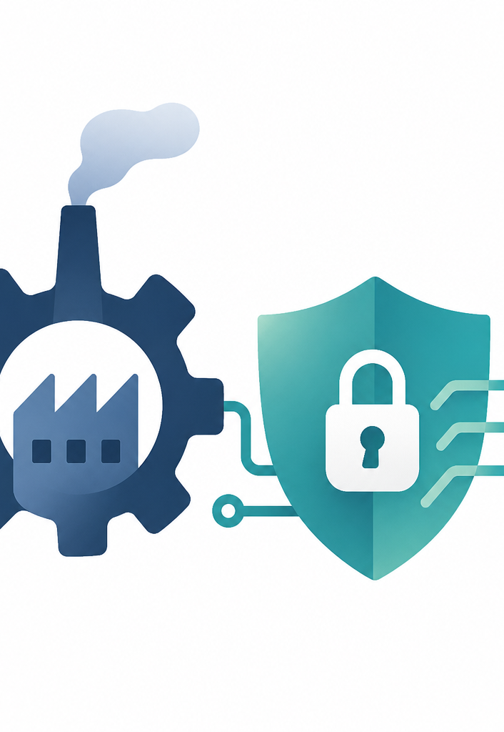
OPERATIONAL TECHNOLOGY SECURITY
Final Summary
NATURE OF OT: CYBER-PHYSICAL SYSTEMS REQUIRING SPECIALIZED SECURITY
OVERSIGHT.
CORE PRIORITIES: AVAILABILITY AND SAFETY REMAIN THE PARAMOUNT
OBJECTIVES.
KEY STRATEGIES:
  Implement robust network segmentation.
  Utilize passive monitoring to maintain visibility.
  Maintain constant coordination with OT staff.
"In OT security, protecting the system means protecting the physical process behind
it."
NEXT: INDUSTRIAL CONTROL SYSTEMS

