Slide 1


Unified Connectivity
Centralized cloud-
delivered platform for
remote users,
branches, and mobile
devices.
Centralized
Management
Identity-Centric
Security
Secure
Access
Service Edge
(SASE)
Consistent policy
enforcement
regardless of location
or device.
Single pane of glass
for monitoring and
policy orchestration.
SASE
Convergence
FWaaS
ZTNA
Cloud-native network
security.
Secure remote access
to applications.
CompTIA CySA+ CS0-004 |
Objective 1.1 | Micro Lesson 16
CASB
SWG
Visibility and control
over SaaS
applications.
Protection against
web-based threats.

Slide 2
Why This Matters: Perimeter Evolution
Adapting security and performance for a decentralized workforce
Traditional Model
SASE Model
Perimeter-based security
Backhauling traffic to data centers
High latency
Centralized bottlenecks
Inconsistent protection for remote users
Cloud-native security
Direct-to-app connection
Optimized performance
Scalable cloud architecture
Consistent security across all locations
Transitioning to SASE removes the physical data center bottleneck, ensuring
secure and high-performance access for a distributed workforce.

Slide 3



Networking
Software-Defined
WAN (SD-WAN) for
optimized, intelligent
traffic routing.
ZTNA
Zero Trust Network
Access
What is
SASE?
Data Protection
SASE
(Secure
Access
Service
Edge)
SWG
Secure Access Service Edge:
Unifying networking and cloud-
delivered security
Unified policy
enforcement
Secure Web Gateway
FWaaS
CASB
Firewall as a Service
Cloud Access Security
Broker
SASE is a comprehensive architectural framework, not a single appliance.

Slide 4
Why the Traditional Perimeter Changed
The transition from fixed perimeters to a distributed digital ecosystem
Workforce Shifts
  Widespread adoption of remote and hybrid work models
  has decentralized the workforce.
Infrastructure Evolution
  Transitioning to cloud-hosted applications, SaaS, and
  multi-cloud environments.
Connectivity Trends
  Increased reliance on mobile devices, branch offices, and
  direct internet access.
Expanded Ecosystem
  Inclusion of third-party users and highly distributed data
  assets across the network.
Visibility Challenges
  The rise of encrypted traffic makes traditional inspection
  and monitoring difficult.

Slide 5
SD-WAN
Traffic optimization
and intelligent path
selection for improved
network performance.
Central Policy
ZTNA
Unified rule
enforcement providing
a single source of truth
for security
governance.
Policy-based access
ensuring users only
reach authorized
applications.
Core SASE
Capabilities
Data Protection
Secure Web
Gateway
SASE
Unified framework for cloud-
native network and security
services
Advanced security
measures to identify
and protect sensitive
information.
Deep web inspection
to block malware and
enforce acceptable
use policies.
FWaaS
CASB
Cloud-native network
filtering to protect
perimeters without
physical hardware.
Visibility and security
controls for cloud-
based applications and
data.

Slide 6
Software-Defined Wide-Area Networking (SD-WAN)
A centralized management and optimization framework for modern enterprise networks
Dynamic Path Selection
  Automatically routes traffic across the best available link
  based on real-time network conditions.
Simplified Branch Connectivity
  Streamlines the deployment and management of
  network infrastructure at remote sites.
Application-Aware Routing
  Prioritizes business-critical applications like VoIP, SaaS,
  and ERP for optimal performance.
Reduced Cost
  Minimizes reliance on expensive private circuits by
  leveraging public internet and hybrid transport models.
SD-WAN serves as the networking foundation for connectivity and is distinct from the security model implemented on top of it.

Slide 7


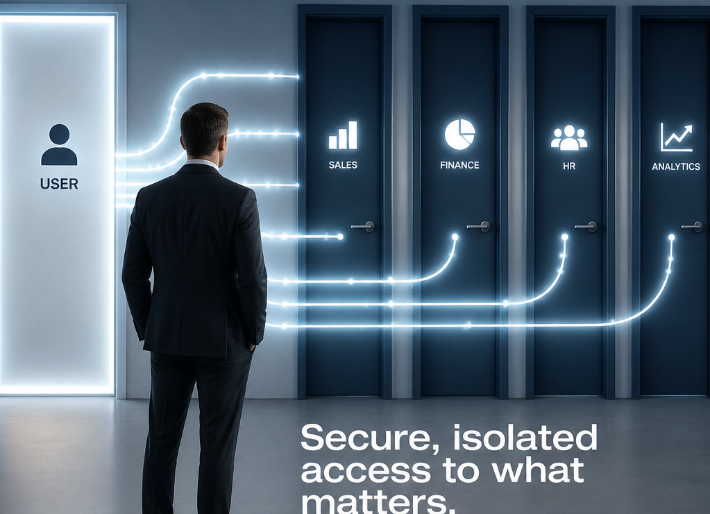
Zero Trust Network Access (ZTNA)
Modernizing Security Beyond Traditional Perimeters
Core Philosophy
Traditional VPN
ZTNA
Identity-centric access and the Principle of Least
Privilege ensure that users only reach resources they
strictly require, rather than the entire network.
Connects users to the network, providing
broad access that potentially exposes
multiple resources simultaneously.
Connects users to specific applications
through secure, segmented, and
granular access control.

Slide 8
SASE vs. Traditional VPN
Comparing Modern Cloud-First Connectivity with Legacy Network Access
Traditional VPN
SASE / ZTNA
Relies on broad network-level access, backhauling traffic to a
centralized data center with static, initial authentication.
Utilizes edge-based, distributed security with application-
specific access based on continuous identity and device
context evaluation.

Slide 9


Secure Web Gateway (SWG)
Protecting enterprise assets through comprehensive web traffic control and policy enforcement
URL Filtering
Download Restrictions
Prevents access to high-risk, malicious, or
prohibited internet destinations.
Enforces policies to prevent the unauthorized
transfer of files.
Malware Detection
TLS Inspection
Scans incoming web traffic for malicious
payloads and threats.
Decrypts and inspects encrypted traffic to
ensure security visibility.
Content/Application Inspection
Monitors and controls user interaction with
specific web applications and content types.

Slide 10


Cloud Access Security Broker (CASB)
The Control Point for Cloud Visibility & Policy
Cloud Visibility
Policy Enforcement
Comprehensive discovery of all cloud
applications in use across the enterprise.
Consistent application of data-handling rules
and security protocols.
Shadow IT Management
Threat Detection
Identification and assessment of unauthorized
or unsanctioned cloud services.
Advanced identification of unusual behavior
indicative of compromised accounts or insider
threats.
Activity Monitoring
Continuous tracking of user behavior and
interactions with cloud environments.
CASBs serve as the critical bridge for secure user-to-cloud interaction.

Slide 11


Firewall as a Service (FWaaS) & Data Protection
Cloud-native network security and data integrity strategies
Cloud-delivered FWaaS
Traffic Filtering & Egress Control
IDS/IPS
Scalable, centralized traffic monitoring and security
policy enforcement.
Granular control over network traffic and secure
management of outbound data to prevent exfiltration.
Real-time threat detection and automated prevention of
malicious activities.
Data Loss Prevention (DLP)
File Inspection & Encryption
Identifying, blocking, and classifying sensitive data transfers with automated tagging.
Deep packet inspection for threats and protecting data at rest and in transit.
Implementation strategies are tailored to meet specific organizational compliance and operational requirements.

Slide 12



Policy and Identity Context
The Policy Decision Flow
Context Signals (Input)
Policy Engine (Processor)
Enforcement (Outcome)
Aggregates identity, device posture,
resource classification, actions,
location, and risk scores.
Evaluates incoming signals against
predefined security and compliance
policies.
Applies the final decision: Permit,
Restrict, Inspect, or Deny access.
The policy decision flow transforms raw signals into actionable security outcomes through systematic evaluation.

Slide 13




SASE Telemetry for the SOC
Essential evidence sources and analyst requirements for effective investigation
Identity & Access
Web & Network
Cloud & Data
Infrastructure
Authentication events and
ZTNA policy decisions
DNS requests and Web
filtering logs
CASB activity and DLP
violation alerts
FWaaS logs and SD-WAN
path telemetry
Analysts must derive context across Who, Device, Application, Action, and Outcome to effectively investigate and respond.

Slide 14
Common SASE Security Gaps
Critical misconfigurations and operational oversights in SASE architectures
Broad ZTNA Access
  Implementing overly permissive
  policies that violate the principle of
  least privilege.
Weak MFA
  Failure to enforce robust multi-
  factor authentication across all
  users and applications.
Unmanaged Devices
  Lack of visibility and security
  controls for personal or non-
  corporate managed hardware.
Incomplete Inspection
  Insufficient SSL/TLS inspection,
  allowing threats to bypass security
  checks via encrypted traffic.
Disabled Logging
  Inadequate audit trails, hindering
  forensic analysis and threat
  detection.
Poor IDP Integration
  Fragmented identity management
  causing inconsistent access
  control.
Direct Bypass Paths
  Configuration errors or legacy
  network routes that allow traffic to
  circumvent security gateways.
Note: Centralizing security policy is not a replacement for accurate configuration and consistent enforcement.

Slide 15
Realistic SOC Scenario
Incident Analysis, Defensive Controls, and Response Strategy
Incident Overview
Defensive Controls
Incident Response Actions
Detection of unauthorized access
from a non-compliant device,
including sensitive data exfiltration to
unsanctioned cloud storage.
Implementation of geo-risk analysis,
adaptive authentication, device
compliance checks, and CASB
policies to mitigate risk.
Immediate session termination,
device isolation, and forensic log
preservation for thorough post-
incident analysis.

Slide 16


Analyst Validation Checklist
Standardized protocol for ZTNA session investigation
Identify User/Device
Review Auth Strength
Verify ZTNA Decision
Examine Logs
Verify the legitimacy of the user
and endpoint health status.
Ensure MFA compliance with
organizational standards.
Confirm the specific policy
decision triggered for the session.
Audit web/cloud traffic patterns
for suspicious activity.
Check DLP Alerts
Monitor Duration
Confirm Policy Adherence
Analyze data loss prevention logs for
unauthorized egress.
Evaluate session timeline for unusual persistence
anomalies.
Validate that no manual overrides bypassed
security controls.
Correlation: Synthesize all log sources to build a comprehensive narrative of session behavior.

Slide 17
Exam Decision Rules
Memory aid for evaluating and applying the SASE framework
Connect
Access
Inspect
Control
SD-WAN
ZTNA (Zero Trust
Network Access)
SWG (Secure Web
Gateway)
CASB (Cloud Access
Security Broker)
Filter
Protect
Decide
FWaaS (Firewall as a Service)
DLP (Data Loss Prevention)
Identity/Context

Slide 18
Knowledge Check: SASE & Security Components
Key concepts in modern network and cloud security
VPN vs. ZTNA
  VPNs grant broad network-level access, whereas ZTNA
  provides granular, identity-based access to specific
  applications.
CASB Purpose
  Ensures security, visibility, and compliance between
  cloud service users and cloud applications.
SWG Function
  Acts as an inspection point to filter malicious traffic and
  enforce web-usage policies.
Managing Noncompliant Sessions
  Utilize Conditional Access tools to block access, require
  MFA, or enforce read-only restrictions.
SD-WAN Role
  Optimizes traffic paths and enables direct, secure
  internet access from branches to cloud resources.

Slide 19

Summary
Final Summary
Architectural Model: SASE is a comprehensive cloud-
delivered framework, not a standalone product.
Core Principle: Focuses on secure connectivity by
validating the right identity, from the right device, to the
right resource.
Next Lesson: Hybrid-Cloud Security Architecture.
SASE enables secure, identity-centric connectivity in a cloud-delivered model.

